Slide 1


Go-Session-4.2
---------------------
Synchronous Vs Asynchronous Channels
By Shadab Akhtar

Slide 2
--------------------------------------------------------------------------------------------------
Module Introduction
--------------------------------------------------------------------------------------------------
In this module, we will cover
-------------------------------
Synchronous Vs Asynchronous Channels

Slide 3
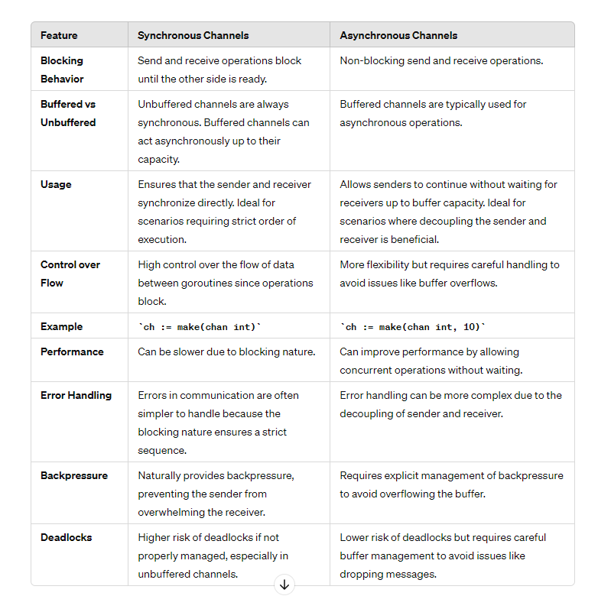

Slide 4
### Explanation:
1. **Blocking Behavior**:
- **Synchronous**: Operations on unbuffered channels block until both a sender and a receiver are ready.
- **Asynchronous**: Buffered channels allow send operations to proceed without waiting for a receiver up to the buffer limit.
2. **Buffered vs Unbuffered**:
- **Synchronous**: Unbuffered channels.
- **Asynchronous**: Buffered channels, which can hold a limited number of values before blocking.
3. **Usage**:
- **Synchronous**: Suitable for tight synchronization requirements.
- **Asynchronous**: Suitable for scenarios needing loose coupling between sender and receiver.
4. **Control over Flow**:
- **Synchronous**: Precise control over data flow, ensuring sender and receiver operate in a lockstep fashion.
- **Asynchronous**: Allows decoupling, enhancing flexibility but requiring careful management.
5. **Example**:
- **Synchronous**: `ch := make(chan int)` (unbuffered).
- **Asynchronous**: `ch := make(chan int, 10)` (buffered).

Slide 5
6. **Performance**:
- **Synchronous**: Potentially slower due to waiting.
- **Asynchronous**: Can be faster as operations can proceed without waiting.
7. **Error Handling**:
- **Synchronous**: Simpler, as operations occur in a strict sequence.
- **Asynchronous**: More complex due to the independent timing of send and receive operations.
8. **Backpressure**:
- **Synchronous**: Naturally provides backpressure by blocking the sender.
- **Asynchronous**: Requires explicit backpressure management to prevent buffer overflow.
9. **Deadlocks**:
- **Synchronous**: Higher risk if not managed carefully.
- **Asynchronous**: Lower risk of deadlocks, but potential issues with buffer limits.
By understanding these differences, you can choose the appropriate type of channel for your specific use case in Go programming.

Slide 6
--------------------------------------------------------------------------------------------------
Module Summary
--------------------------------------------------------------------------------------------------
In this module, we have covered
-------------------------------
Synchronous Vs Asynchronous Channels

Slide 7


